Slide 1

The MetroGnomes
Notes:
0:30

Slide 2
The Impact
Amazon set off a massive bidding war with its announced on Sept. 7, 2017, that it was seeking proposals for what it dubbed HQ2, a $5 billion project with 50,000 employees that would complement the company’s existing headquarters in Seattle.
The company received bids from 238 locations across North America.
They settled on Virginia, who offered 750 million.
Some states, most notably New Jersey and Maryland, offered multibillion-dollar incentive packages — $7 billion and $8.5 billion
In their final decision, they created 25,000 jobs in Virginia. 25,000 across their other existing business, and an additional 5,000 in Nashville, TN.
Collecting overall estimated 4 billion in incentives.
max growth
Notes:
Virginia offers the best workforce in the nation, according to the CNBC 2019 America’s Top States for Business study, with the nation’s largest concentration of science, technology, engineering and math (STEM) employees. The state also ranks No. 1 for education, tied with Massachusetts.
They not only looked for monetary gain they wanted to find somewhere that flourished. (NJ ranked 45th in stable and friendliness in the workplace)
1:30

Slide 3
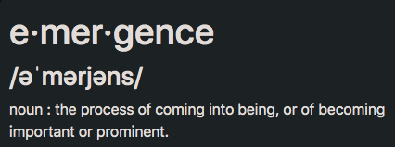
Finding the Emerging Cities in 2024
What makes a city emergent?
The rate at which an area is growing will be reflected in economic statistics like GDP and business applications, and also in demographic statistics like population.
king for places to settle down and invest in real estate.
Finding the next emerging city in advance could save/make thousands and millions of dollars for people looking to invest or find a city with job security.
It can also save/make companies millions of dollars to move to a city with the population, demographics, and employment ratios to find the right talent to employ a workforce.
Notes:
0:30

Slide 4
The Data
We gathered data for 381 cities (metropolitan areas) from the Bureau of Labor and Statistics and the U.S. Census for the last 5-10 years.
The data we pulled included:
Population
unemployment rate
GDP
total employment
labor force
business applications
annual wage
employment
Notes:
0:30

Slide 5
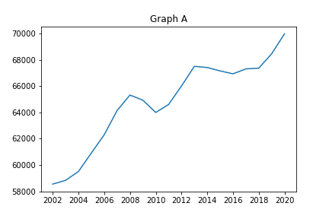
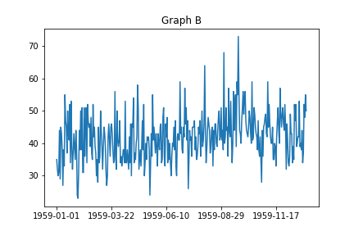
Dissect the Data
Univariate
Multivariate
Seasonality
Trends
Stationary
Non-stationary
Notes:
1:00

Slide 6
ARIMA
(A)uto(R)egressive(I)ntegrated(M)oving(A)verage
Core Concepts
Parameters
AR: uses the dependent relationship between an observation and some number of lagged observations
I: use of differencing of raw observations in order to make the time series stationary
MA: uses the dependency between observation and a residual error from a moving average model applied to lag
p: number of lag observations
d: degree of differencing
q: order of moving average
Notes:
1:00

Slide 7
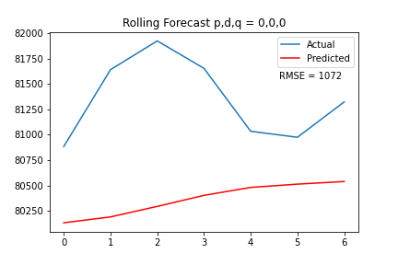
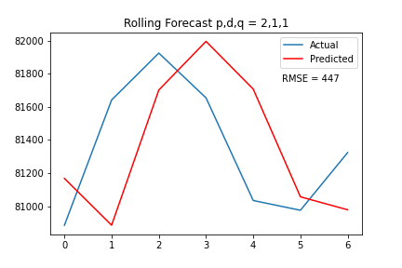
Setting parameters with rolling forecast
Notes:
1:00

Slide 8
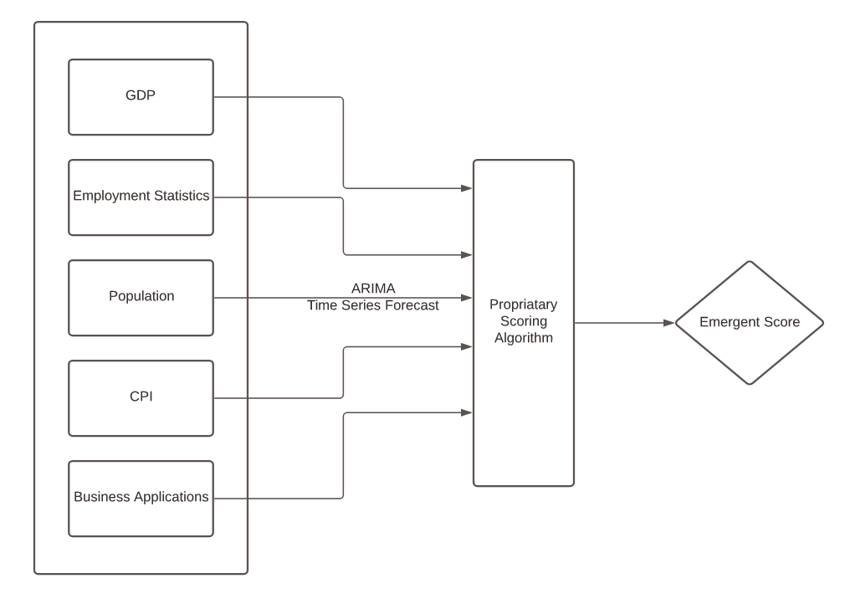

The Machine Learning Model
Notes:
0:30

Slide 9

Customizable dashboard which will rank emerging cities to live in in 2024
https://msa-prediction.herokuapp.com
MetroGnomics is a data analysis tool to help forecast certain emergent conditions for metropolitan areas.
An analytical model was used to project GDP, population, business applications, and various employment measures into the future.
It uses historical data from government sources, and runs them through to produce a ranking score.
Notes:
Dashboard 1:00
About/Forecast 1:30
Comparison 2:00
Info Overview 0:30

Slide 11

Questions?

Slide 12
Appendix

Slide 13






Who Are the “Metro-Gnomes’:
A team of student data scientists trying to solve one of the top questions by corporations, real estaters and millennials.
Josh Severin
Andrej Arsovski
Stephanie Paul
McKenzie Kilburn
Cat de Rohan
Patrick Enlow

Slide 14
DataSet Sources
Population Metro Census Data of population change from 2010 to 2019
https://www.census.gov/data/datasets/time-series/demo/popest/2010s-total-metro-and-micro-statistical-areas.htm
Unemployment Rate Bureau of Labor and Statistics
https://www.bls.gov/lau/#tables
GDP and Total Employment Bureau of Economic Analysis
https://www.bea.gov/data/gdp/gdp-county-metro-and-other-areas
Labor Force
https://api.bls.gov/publicAPI/v2/timeseries/data/
Annual Mean Wage
https://www.bls.gov/oes/home.htm
Business Applications
https://www.census.gov/library/visualizations/interactive/bfs-annual-state-county.html
Consumer price index
https://api.bls.gov/publicAPI/v2/timeseries/data/

Slide 15
About Our Ranking System
We ran the ARIMA model on each dataset to predict 2024 values.
We then took the Rate of Change from 2019 to 2024 values.
From there, we ranked the Rate of Change for the 384 cities.
Lastly, we took all the Rate of Change Ranks and added up the ranks to a produce a final rank
The cities with the highest rate of change received the highest score
Highest Score possible is __
Insert Image of Ranking System or Gnome

Slide 16
Any other information we think would be useful
Using these datasets we used an ARIMA machine learning model to predict the outcome for each feature for the year of 2024. Then using rate of change we ranked the cities.
Then we selected the top 10 cities and declared them to be the emerging cities in 2024.

Slide 17
Pitch Slide (notes currently)
Average american family moves every 5 years
Custom tailor to where/what you want
Finding Real Estate
Finding a Headquarters for your company
Millenials looking for job
In works of a Deep Neuron Learning Model
Weather
Site Selection Consulting
Time Series
This is what it can find /this is what we can do : we can use our product to help meet your need
Finding the next “Emerging CITY” in advance could save/make thousands and millions of dollars for people looking to invest or find a city with job security. It also save/make companies millions of dollars to move to a city with the population, demographics, and employment ratios to find the right talent to employ a workforce
Corporations are always looking for the next place to put their “newest” headquarters or save money to move to a different location.
Millennials are wanting to move to a city with plenty of jobs.
Young adults are looking for places to settle down and invest in real estate.
What can MetroGnomics do for you?
Whether you are making a business decision such as site selection, or just looking to pick a new home town, everyone could use a little direction to find the optimal location. From demographics to economic incentives, we can help guide you through the entire process of setting up shop in a new locale..

